Slide 1
Lab-4
Use an appropriate data set for building the decision tree.
Notes:
Use an appropriate data set for building the decision tree.

Slide 2
Decision Tree
For Classification
For Regression

Slide 3
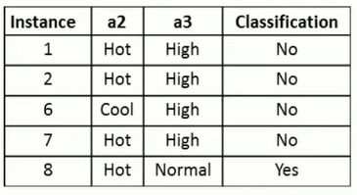
To write in Observation Book
Consider the following dataset, calculate Entropy and information gain w.r.t to target variable “Classification”. Identify whether the splitting node should be a2 or a3 attribute.

Slide 4
Implementation
In your Google Co-lab account, execute following sample python program in the notebook.
Decision_Tree.py

Slide 5
To Do: Implementation – Decision Tree(for Classification)
Write Python code to implement the following. Consider dataset files as “iris.csv” and “drug.csv”
1.
Build a DecisionTree classifier to classify IRIS flower dataset
Use 80% of data for training and 20% for testing.
Display accuracy score and confusion matrix of the trained model on test data.
2.
Build a DecisionTree classifier to classify Drugdataset
Use 80% of data for training and 20% for testing.
Display accuracy score and confusion matrix of the trained model on test data.

Slide 6
To Do: Implementation – Decision Tree(For Classification)
Write Python code to implement the following. Consider dataset file “petrol_consumption.csv”
Build a RegressionTree to predict petrol consumption
Use 80% of data for training and 20% for testing.
Display “Mean Absolute Error, Mean Squared Error, Root Mean Squared Error” for test data.

Slide 7
To Upload to Github
In your github account create folder “6thSem-ML-Lab” and upload your python notebook worked on Decision Tree with file name as “yourUSN_Lab-4-Decision-Tree. ipynb”

Slide 8
To write in the Observation Book
After building the Decision Tree models, write the answer for the following questions in your observation book
1. For “iris.csv” dataset
What was the accuracy score for the IRIS dataset?
What does the confusion matrix tell you about the model's performance? Were there any misclassifications? If so, which classes were most confused?
2. For “petrol_consumption.csv” dataset
Can you interpret the Regression Tree structure? What are the most important features for predicting petrol consumption?
How does the Regression Tree handle continuous target variables compared to the Decision Tree classifier?

